Slide 2
In a few short pages we would like to give you info about the new massive updates at MVM.
We have moved to a much better location
MVM is easy to book you can come to MVM
And after you pay you can immediately come in
And explore MVM
We have also added a space exhibit which is Available to see at MVM

Slide 3
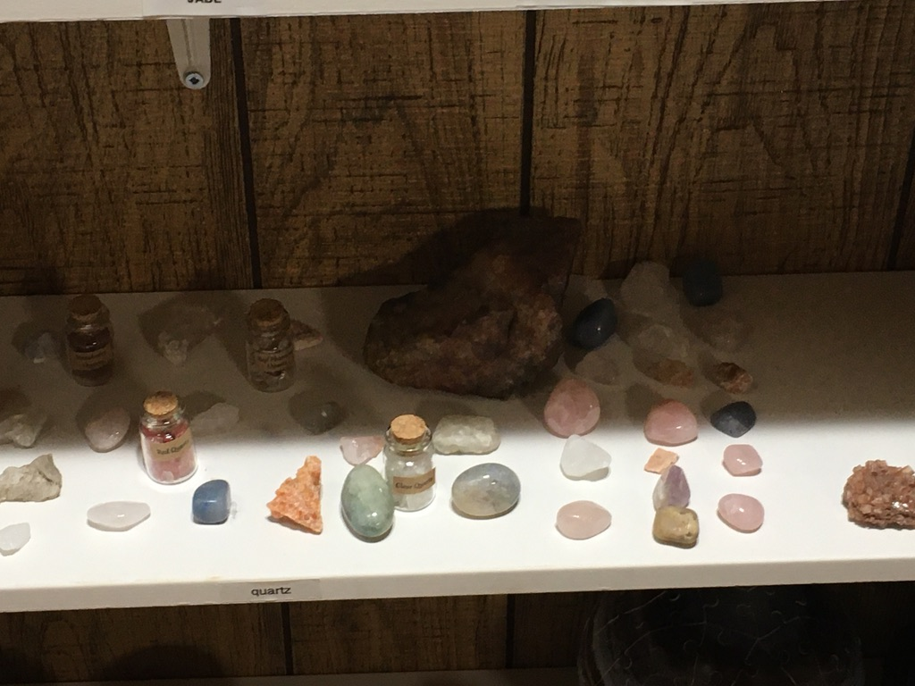
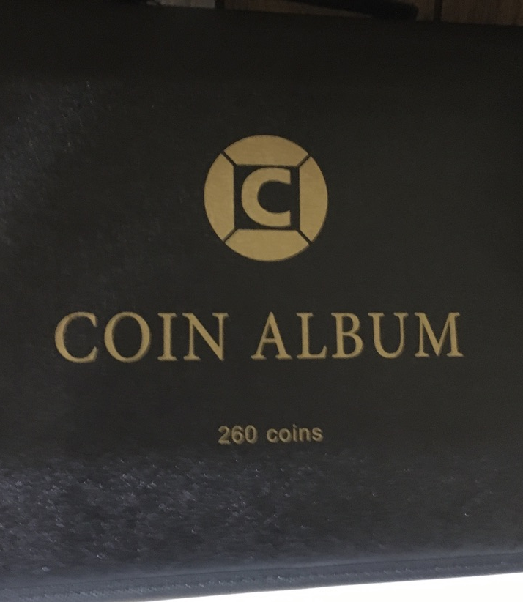
We wanted to share some photos with you of the new MVM updates.

Slide 4
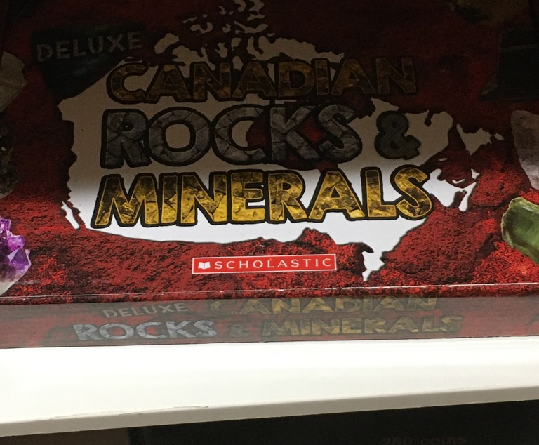
We still have lots of gems
in our archives and we plan to add
more soon!

Slide 5
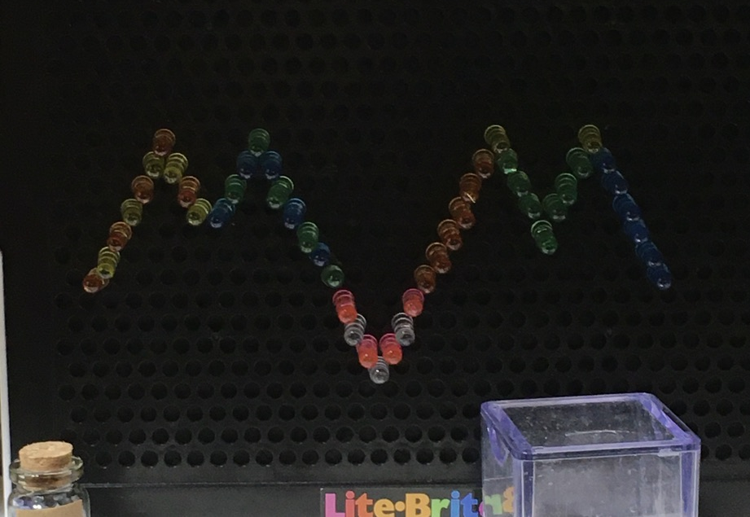

Slide 6
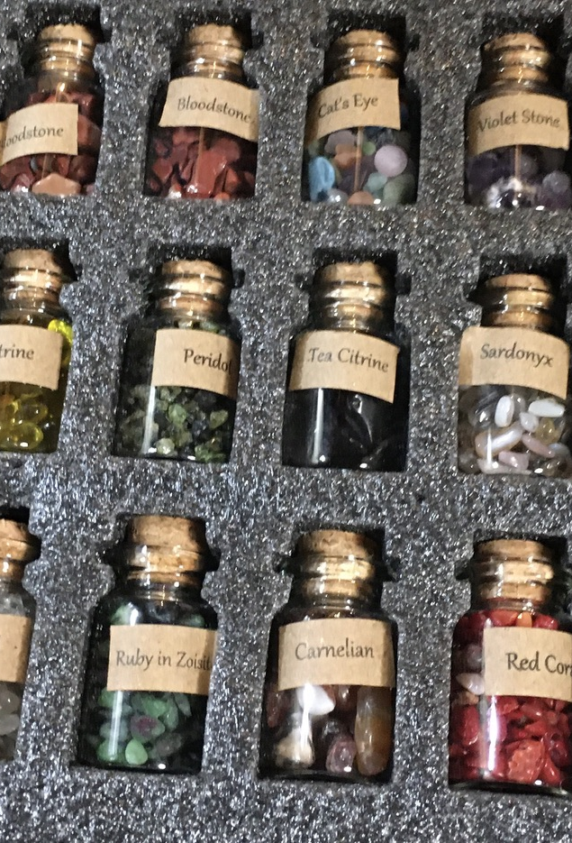
As we said we currently have lots of gems in our archives and if you guys like our new exibits we will add them!

Slide 7
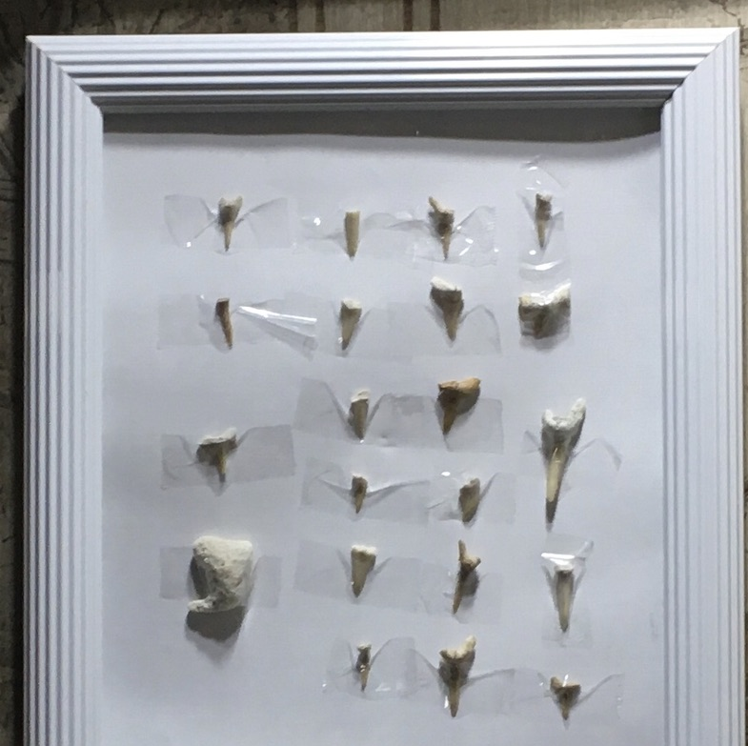
To book a visit at MVM you must either:
Go to MVM and tell the front desk worker when you want to come and they will help you
Show up and pay then explore MVM

Slide 8
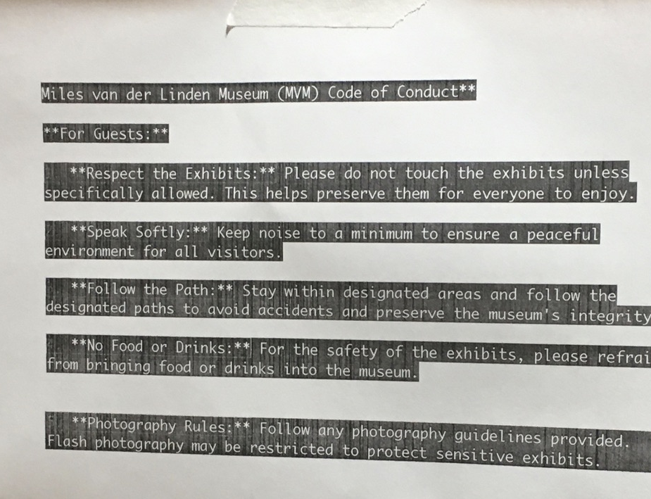
We ask that you follow our code of conduct. If you do not there will be
Punishments starting with verbal warning
If it is repeatedly happening then you could be banned from MVM.

Slide 9
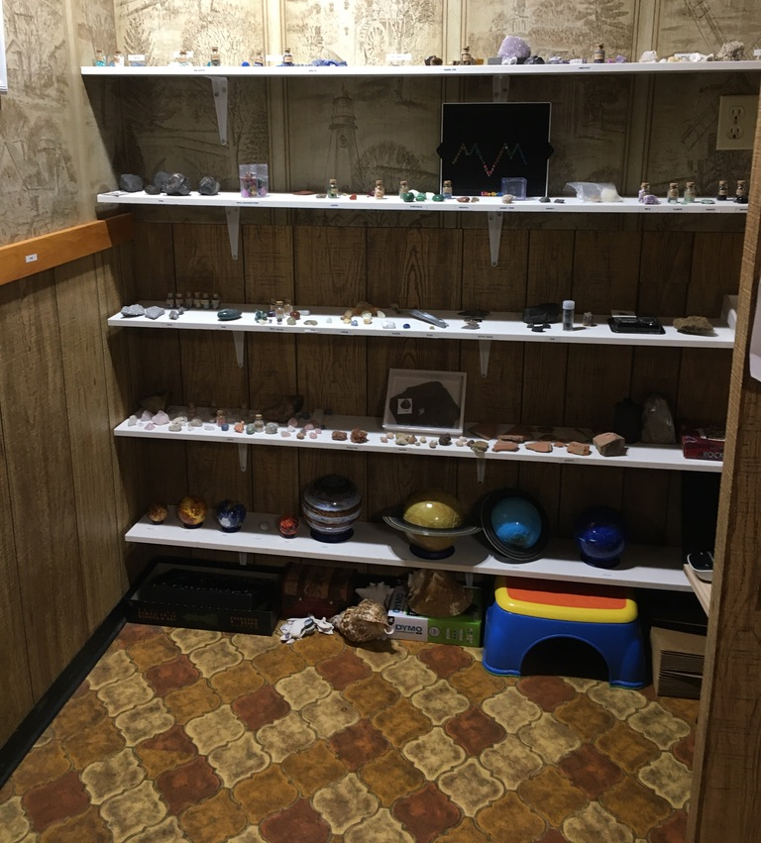
We have a lot of new gemstones and piano books. We have worked really hard on these updates. we hope you like them

Slide 10
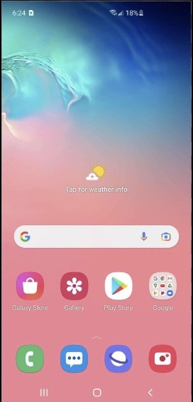
mvmweb.com can be visited on mobile to

Slide 11
Just a heads up MVL library is available to see now.

Slide 12
MVL is a calm library for anyone who just wants to chill with a large Selection of books. We recommend that you stop by!

Slide 13
About MVM

Slide 14
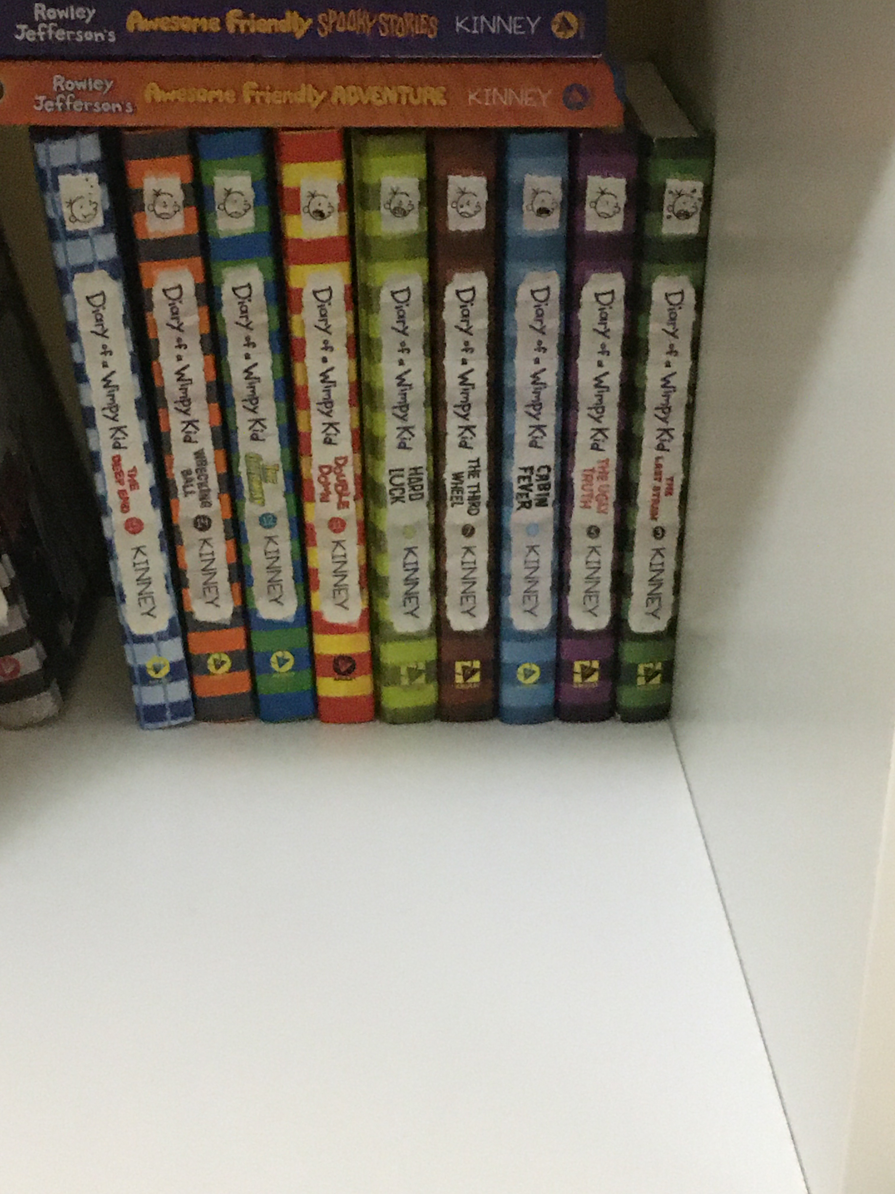
One of our personal Favorites is diary of a wimpy kid we enjoy reading this after a long day!

Slide 15
owners of the MV
franchise
Our names are Bram and Miles.
Visit our YouTube channel. It’s called MVM.
If it does not show up, search MVMweb.com and it will show up.
Send us a message at MVM20241@gmail.com

